Slide 1

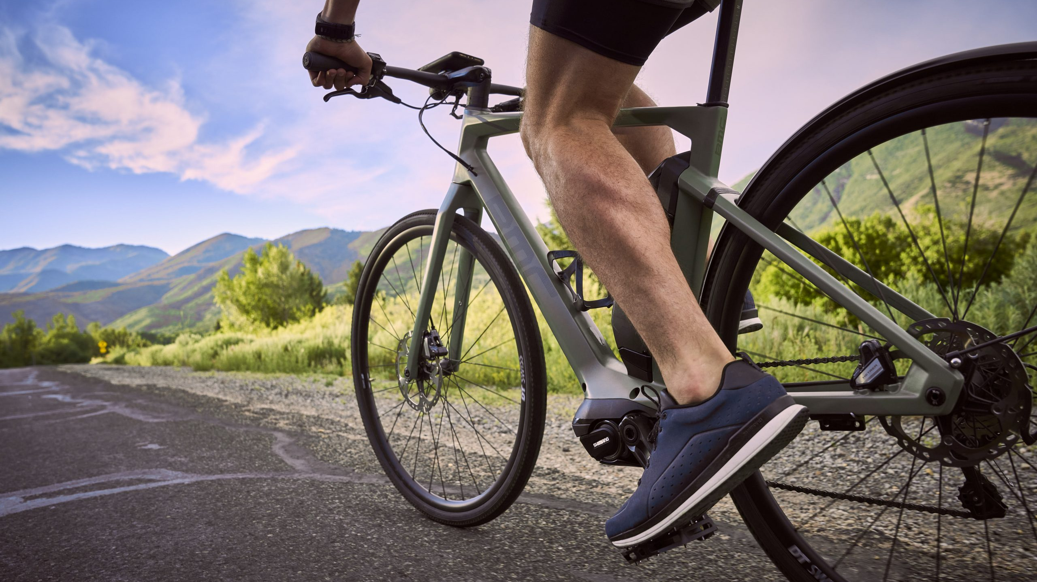
BIKE TYPE SUGGESTER
An easy way to find the right bicycle for you.
BY – ANSHUL RAUTHAN

Slide 2
INTRODUCTION
With more and more people entering into the cycling scene, they must have a way to find the right bike for them.
Choosing a bicycle that suits your needs is crucial to get the best value out of your hard earned money
With so many types of bikes out there people get confused as to which bike will suit them

Slide 3
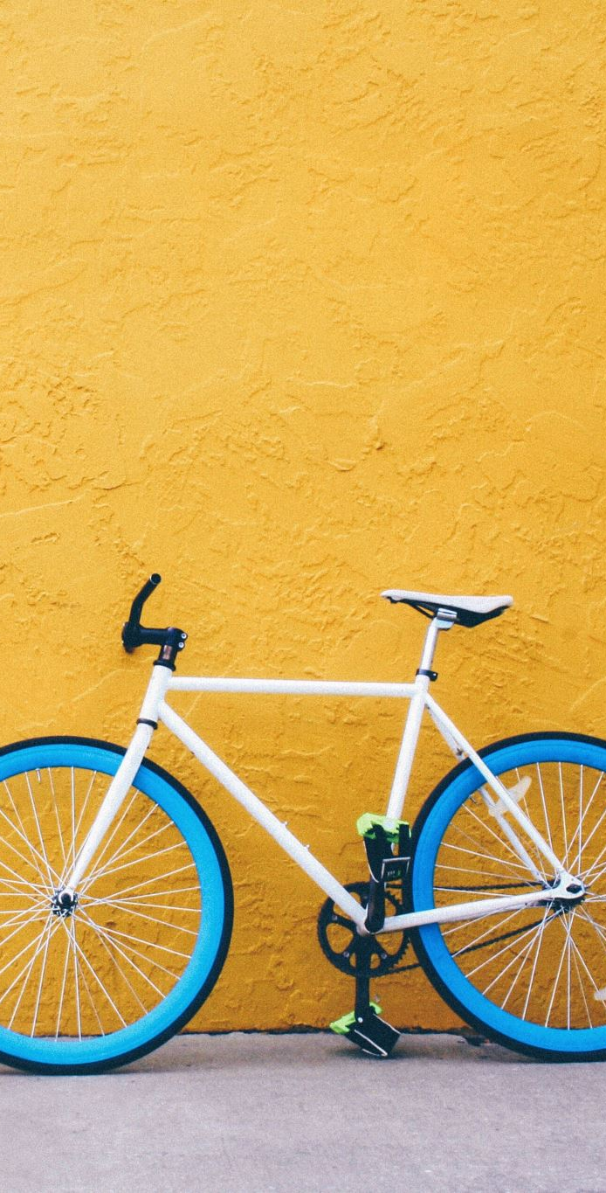
WORKING OVERVIEW
This recommender collects data from the user by asking question
Then based on those questions, it recommends the user a bike type
Additionally, it automatically opens a website that has the selected type of bikes for sale

Slide 4
CODE STRUCTURE
This model is coded entirely on C++ using DEV-C++ 5.11
The code for this recommendation model is rather simple, it is simply questioning based recommendation.
This model opens the websites as per the user’s choice using urls that are stored in a header file.

Slide 5
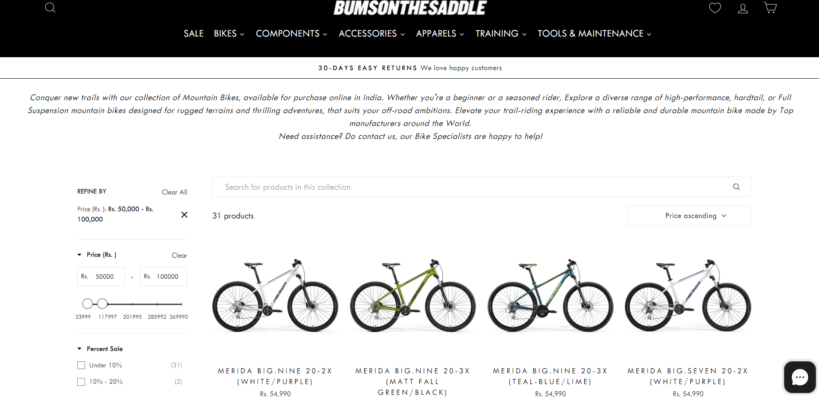
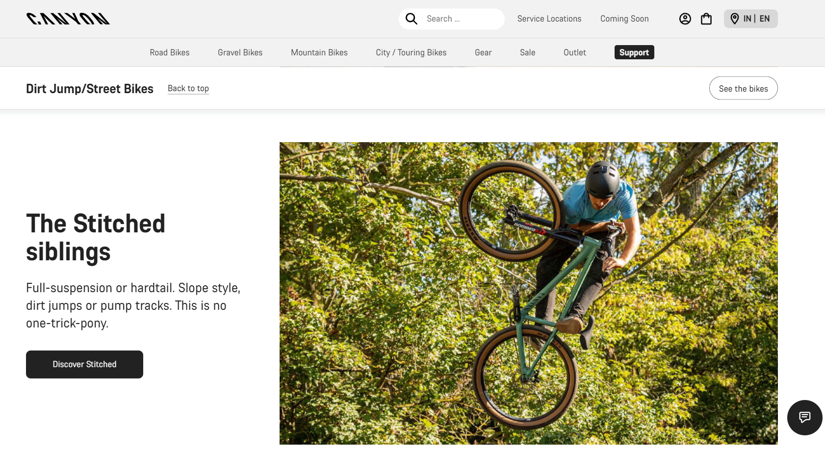
WEBSITES INTEGRATION
The recommender not only provide with a verdict, but it also opens up a website that sells/ displays similar types of bikes (the type which was recommended)
Top retail Websites like ‘choose my bicycle’, ‘bums on the saddle’,’canyon’, ‘polygon bikes’ & ‘gt bikes’ to choose from

Slide 6
PROGRAM WORKING FLOW
CHECK USER EXPERIENCE
INPUT USER BUDGET
ACCORDING TO THESE PARAMETERS, CALL THE RESPECTIVE FUNCTION
ASK THE USER ABOUT MORE PREFERENCES (USAGE, TYPE, ETC)
DISPLAY THE VERDICT & OPEN THE RESPECTIVE WEBSITE

Slide 7


A bike for everyoNE
SUCCESS RATE
BEGINNERS – 9/10
INTERMEDIATE – 7.5/10
PROFESSIONALS - 8/10
ALMOST ALL BIKE TYPES COVERED
MTB
ROAD
GRAVEL
HYBRID
FREESTYLE

Slide 8
BENEFITS
I have made this model and the categorization based on a decade of my experience with cycling, hence reducing the need of an external data set.
01
The price brackets and questions are based on real life questions people have asked me, therefore they are more apt and to the point.
02
The websites my model redirects the user to, are trusted and offer good servies.
03

Slide 9
FUTURE ADDITIONS to the model
Adding a SELF-LEARNING AI to the model (The current prediction is based on predefined data)
Adding more bike types
Refining the questioning process
Addition of a GUI to the model
Providing more options to choose from
Adding more budget brackets

Slide 10
THANK YOU FOR WATCHING
SUGGESTIONS & CRITICISM ARE MUCH APPRECIATED

